Slide 1
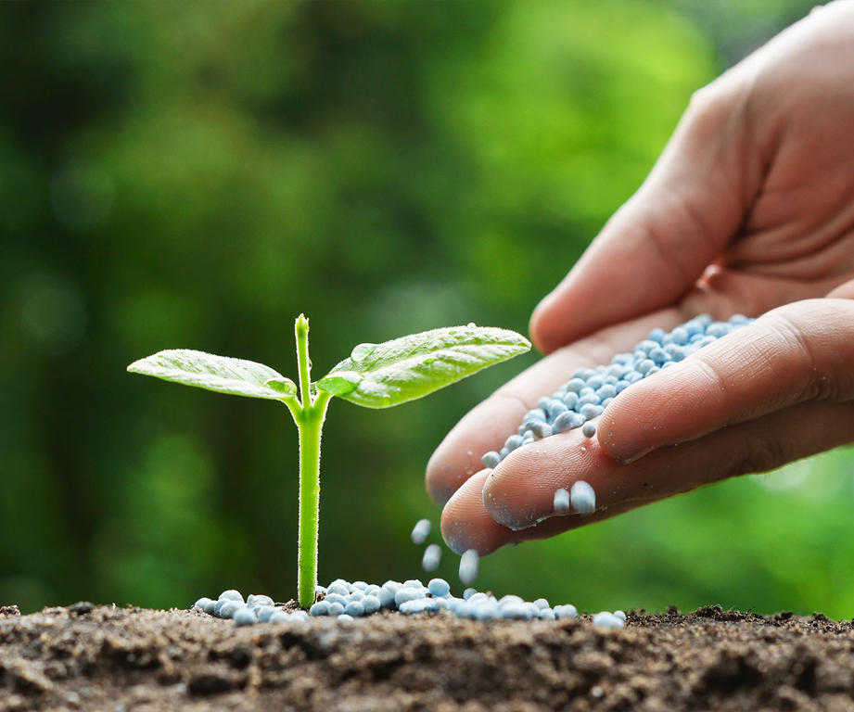
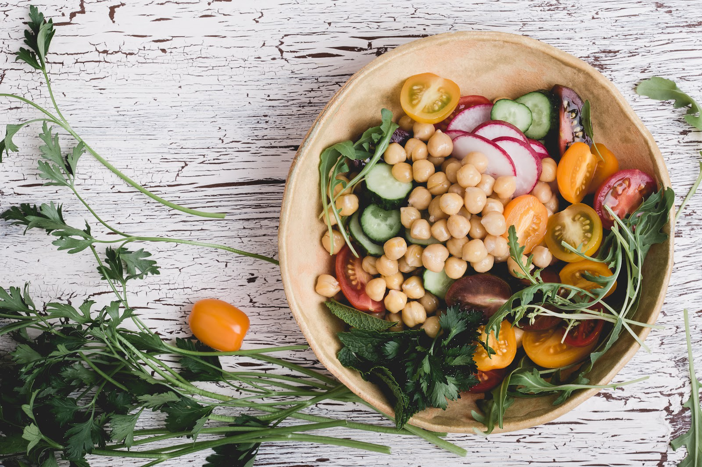
A SMART PLANT DISORDER IDENTIFICATION SYSTEM
CropMedic 2.0

Slide 2
Research Problem
1
39.4%
Agriculture’s contribution to global GDP [1]
2
43%
Agriculture’s contribution to global export market [1]
3
42%
Agriculture production loss due to plant diseases [2]
Leading cause of plant diseases is nutrition deficiency [3]
4
5
Feasible smart solution for early detection of nutrition deficiencies recommending accurate chemical remedies

Slide 3


COMPONENT ONE
Identification of nutrient deficiency in plants
IT17110808 – M.Sukanya

Slide 4

Research Problem ?
How to distinctly identify the presence of nutrient deficiency in a particular plant?
Many Nutrient deficiencies have similar symptoms

Slide 5
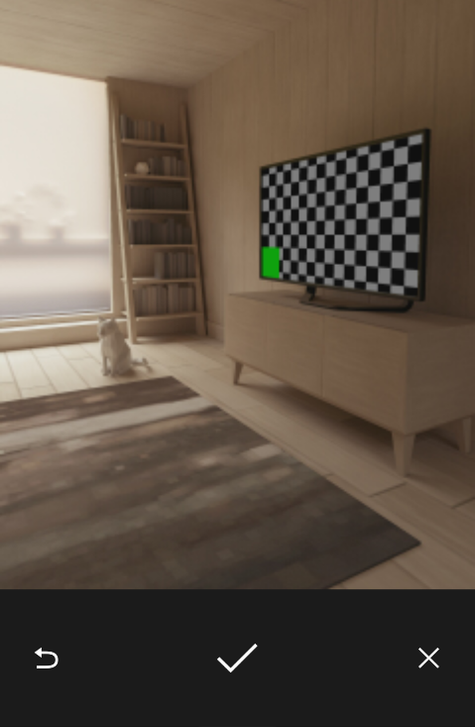
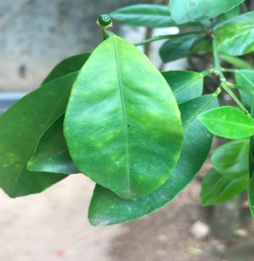
FINAL SOLUTION
A mobile application that captures the image and
identify the nutrient deficiency in plants with more
accuracy

Slide 6
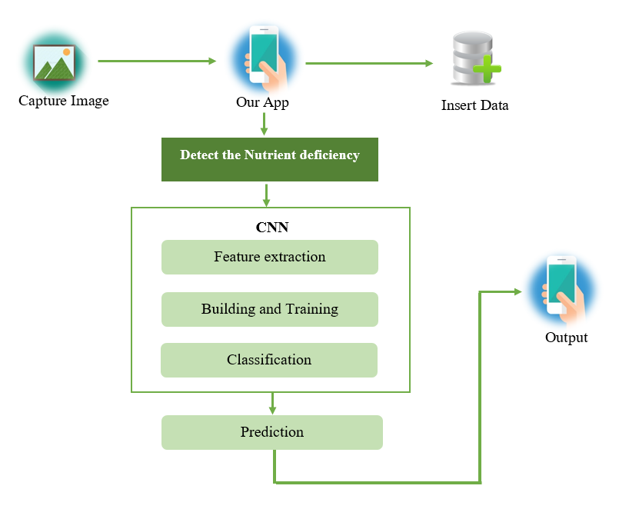
Solution implementation
Nutrient Deficiency Prediction Using
the CNN Model.
01
Develop interface for the mobile
application using Flutter
02

Slide 7
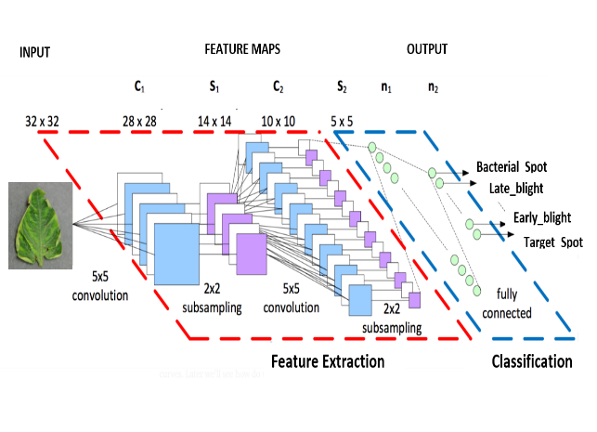

Nutrient deficiency prediction using CNN
1
Data Collection
2
Image Preprocessing
N
P
K
3
Build CNN Model
4
Visualization of images after every layer
5
Training CNN with Parameters
6
Save the Model and Model Weights
7
Prediction

Slide 8
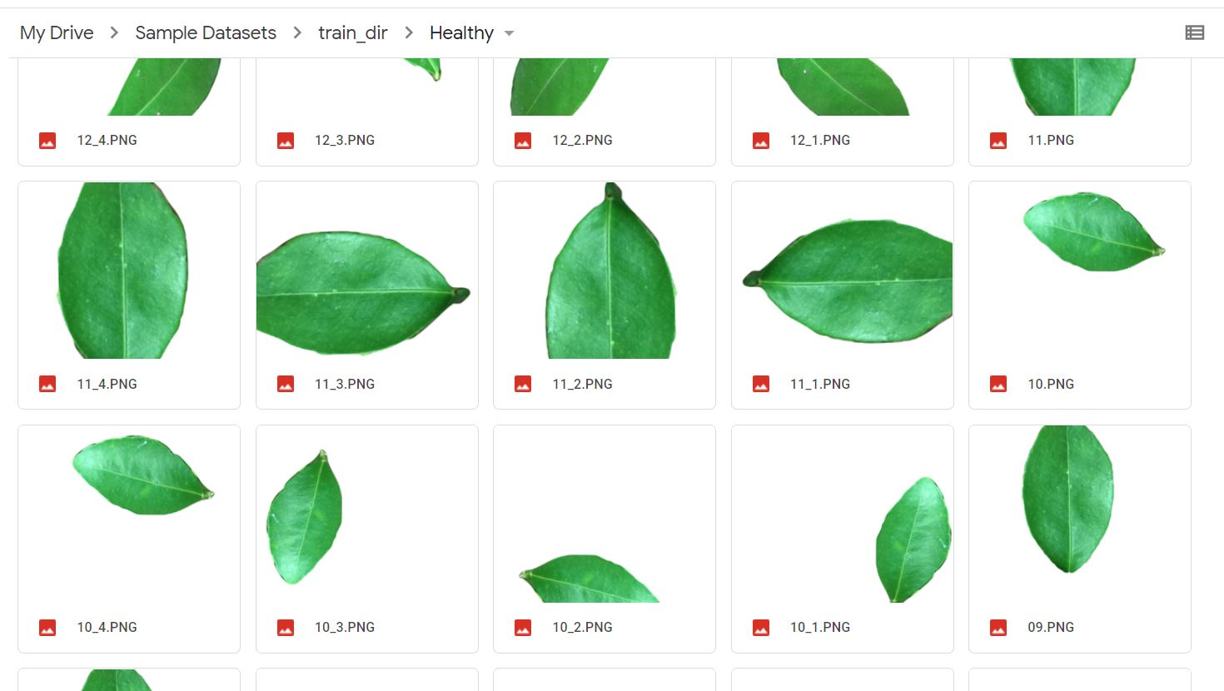
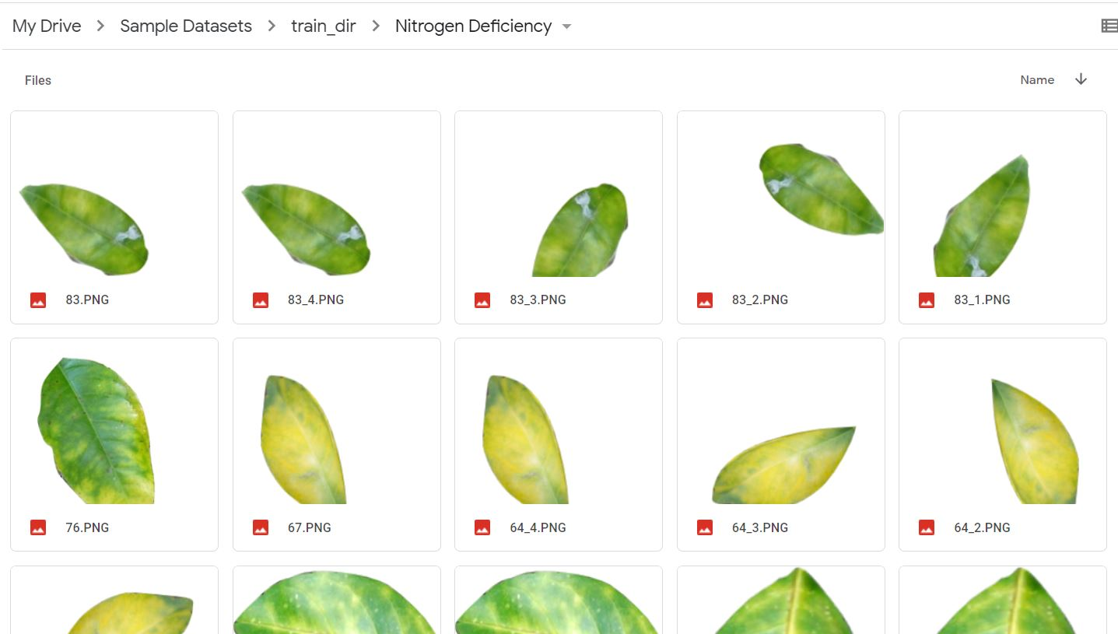
Data Collection
268 Images of Citrus Plant
02 Classes
Healthy
Nitrogen Deficiency

Slide 9
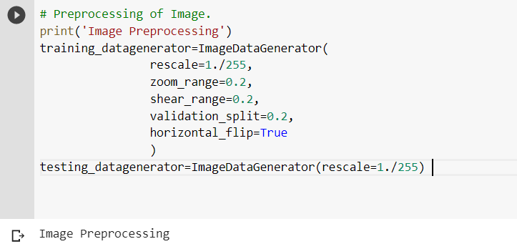
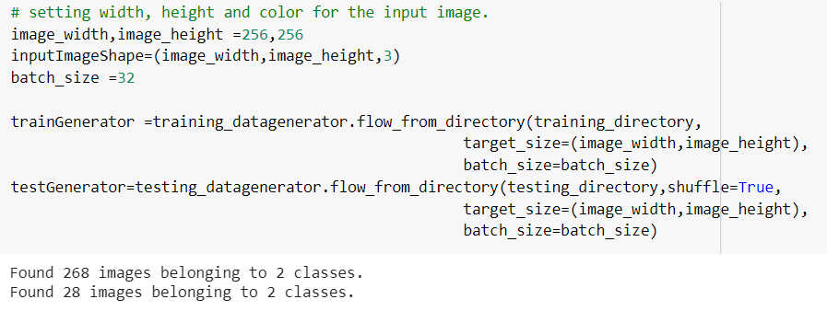
Image preprocessing
Data Standardization
Rescale the Image
Horizontal Flip Image
Zooming and Shear Transformation of Image
Data Augmentation
Resize Image

Slide 10
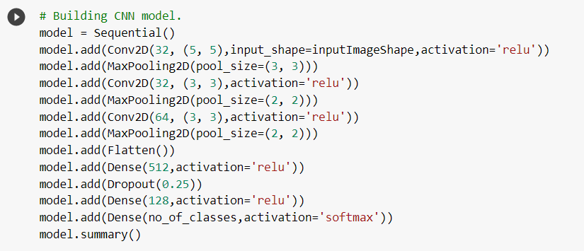
Building CNN Model
32 Features Extract from the Input Image
ReLU Rectified Linear activation to fire up neurons
Flatten layer 4D array to 1D array
Softmax activation for probability results
Dropout makes some neurons to relax

Slide 11
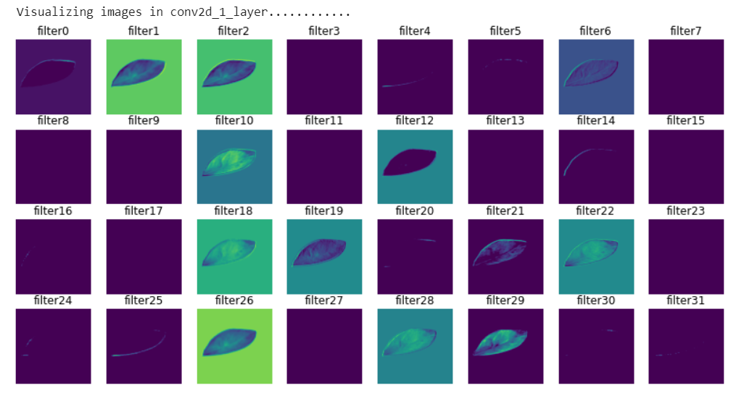
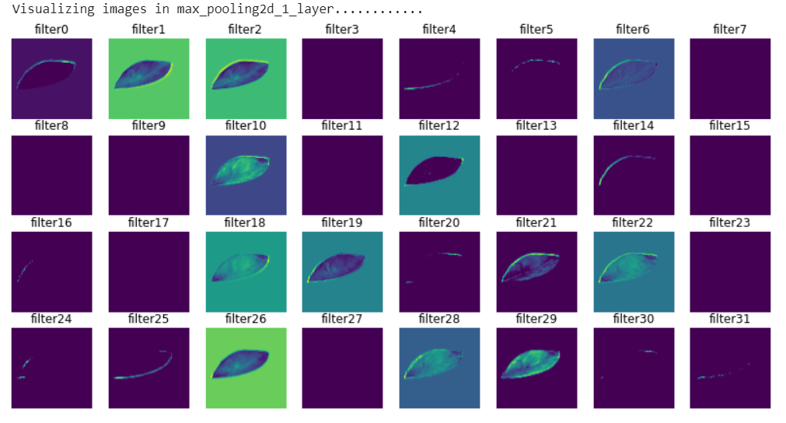
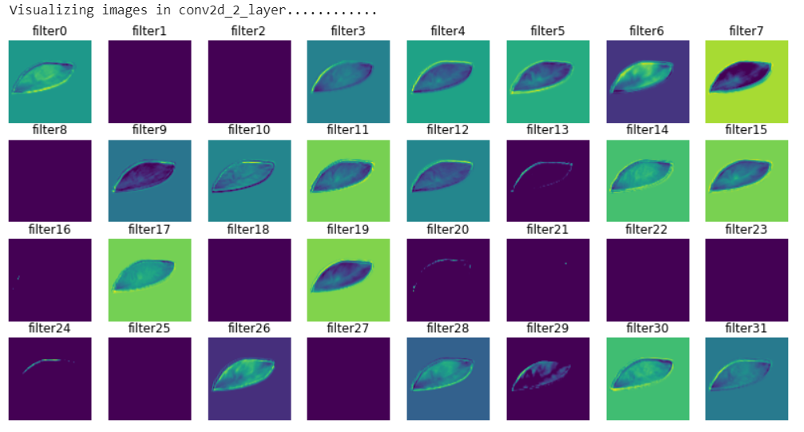
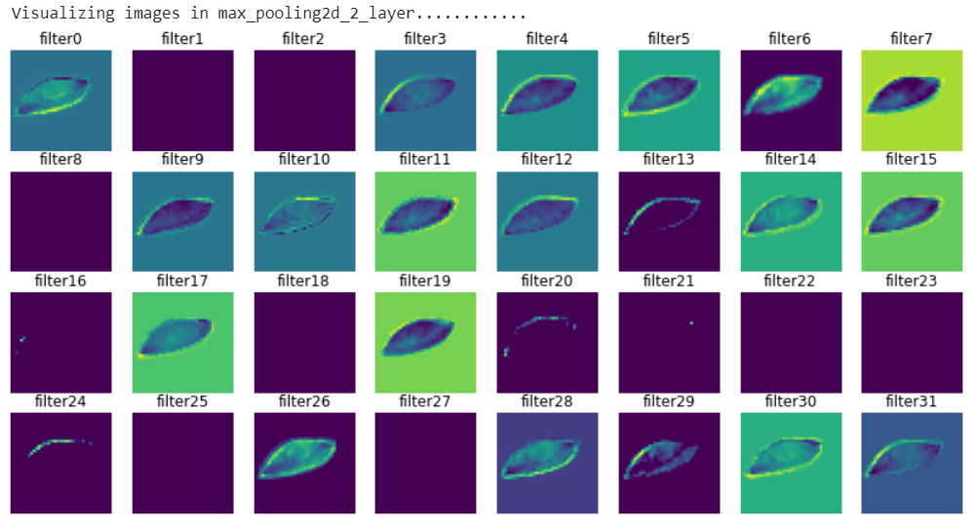
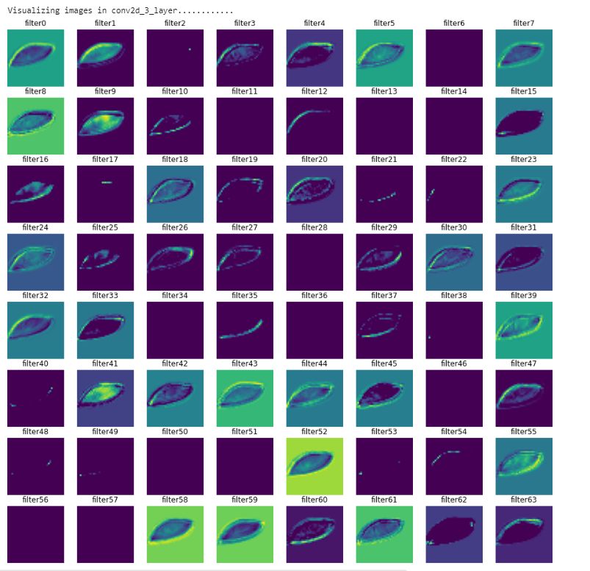
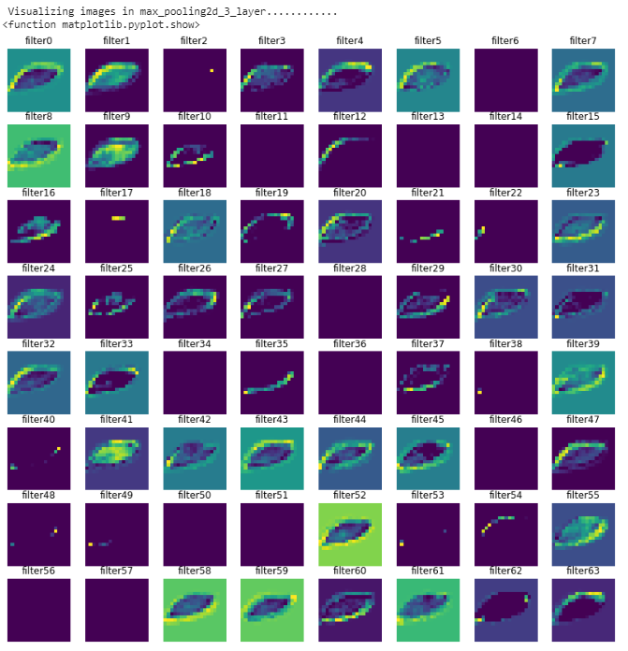
Visualization of Images in every layer

Slide 12
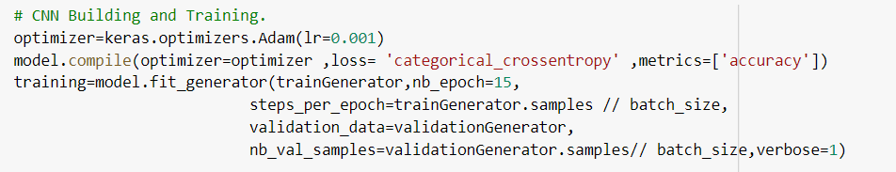
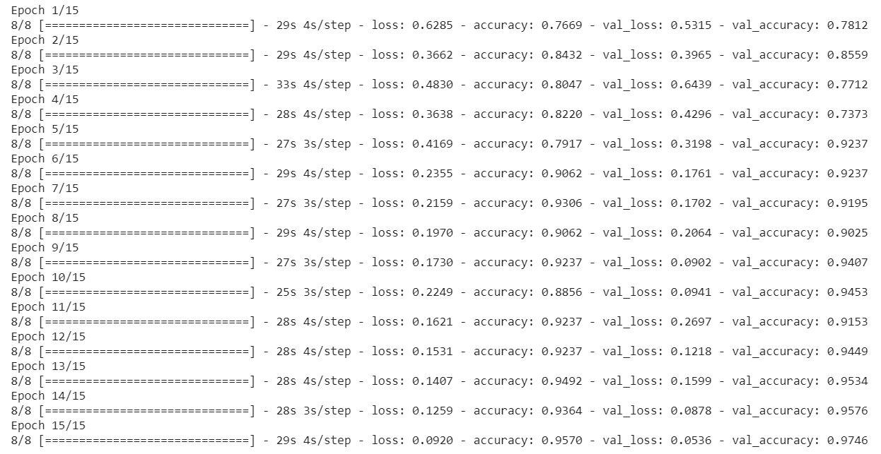
Training CNN with parameter
Adam optimizer is used with the learning rate = 0.001
Fit_generator used to train the CNN Model.
Metrics : Accuracy
Model Accuracy = 0.9746

Slide 13
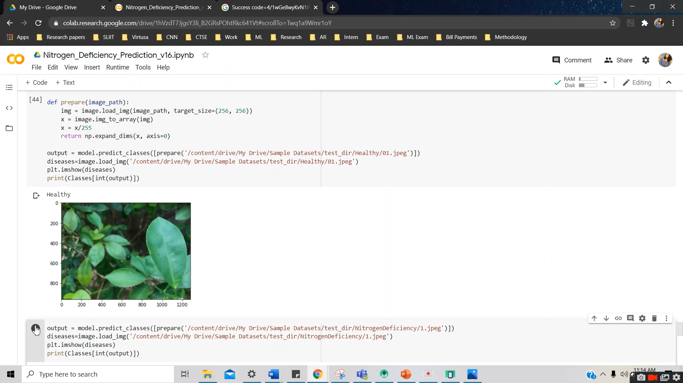
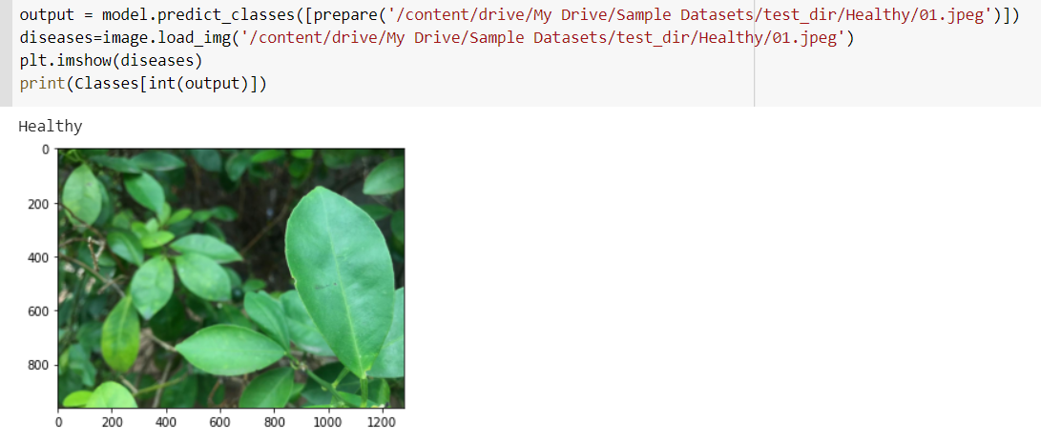
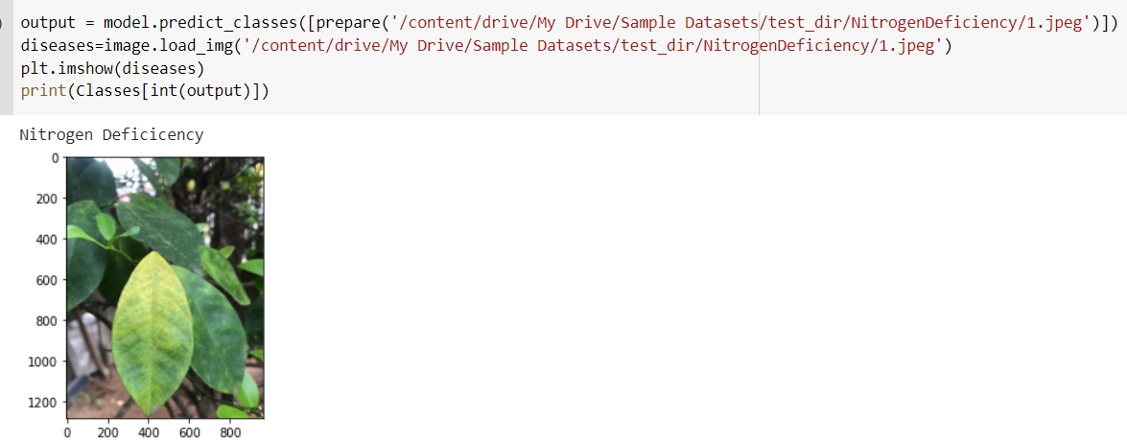
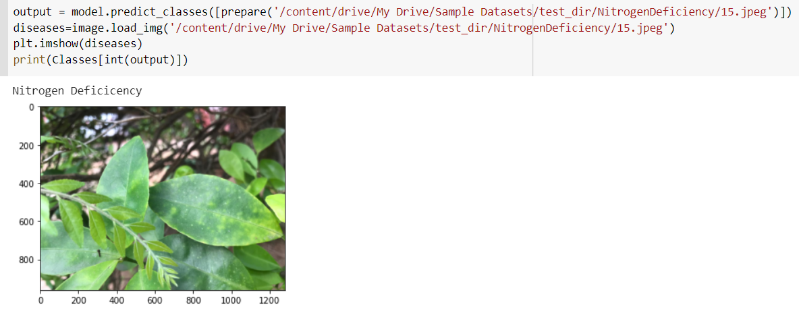
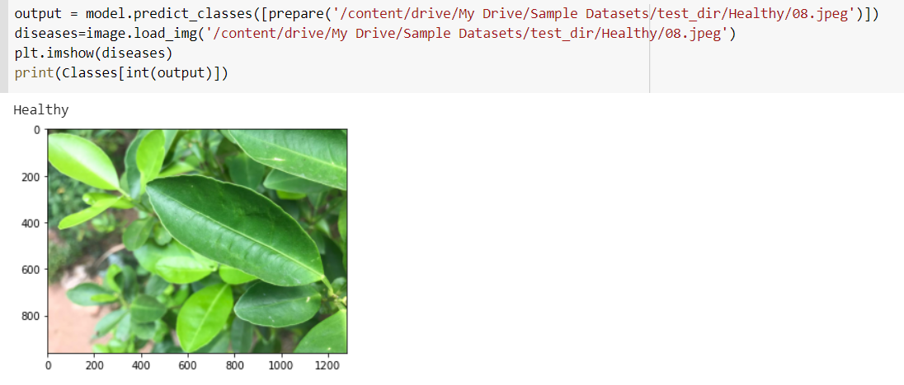
Predictions

Slide 14
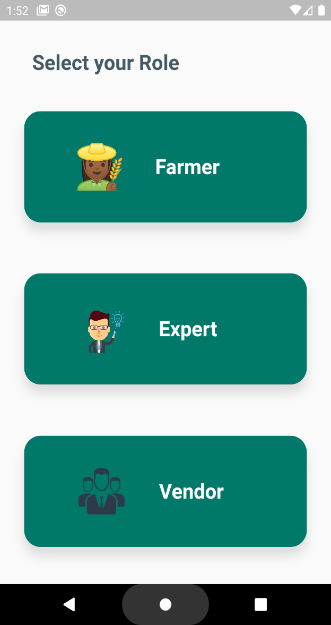
Mobile App Interfaces
User can select their role

Slide 15
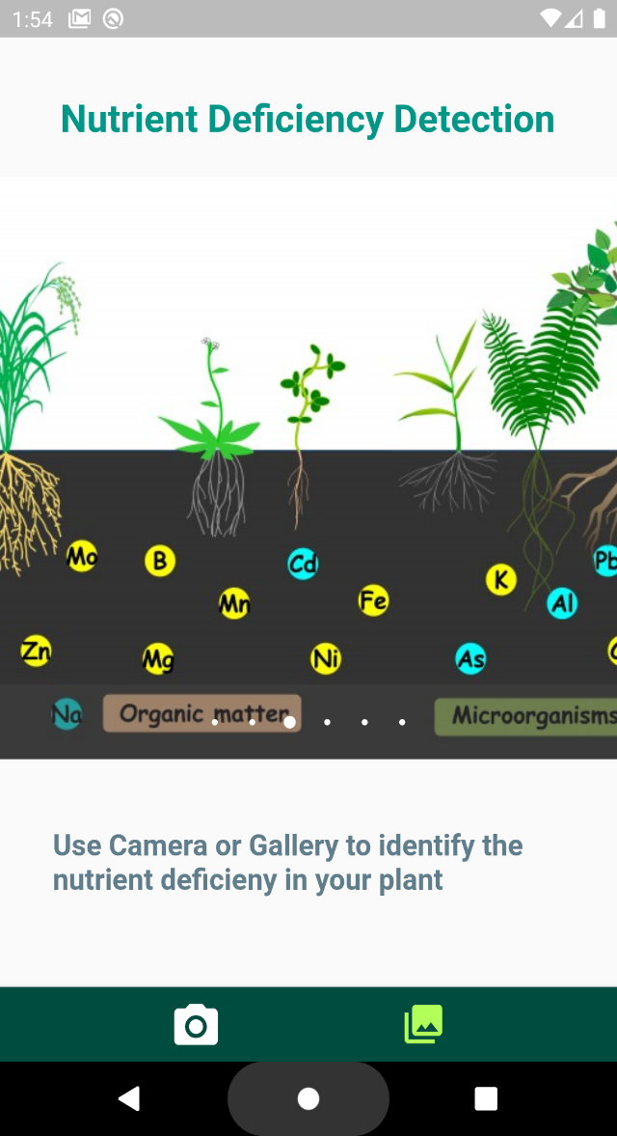
Ability to capture image of crop leaves
Ability to upload images from the gallery

Slide 16
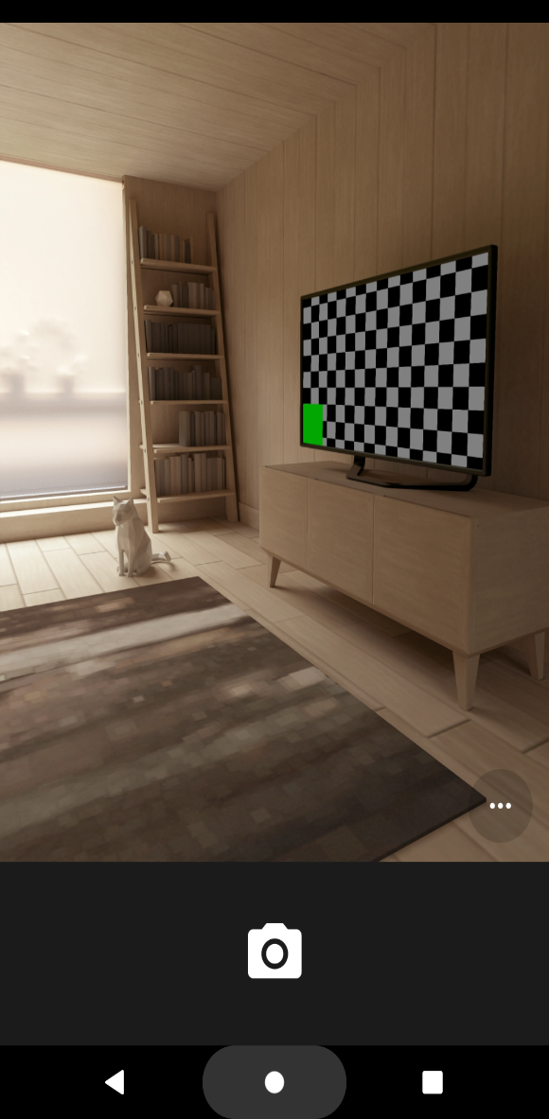

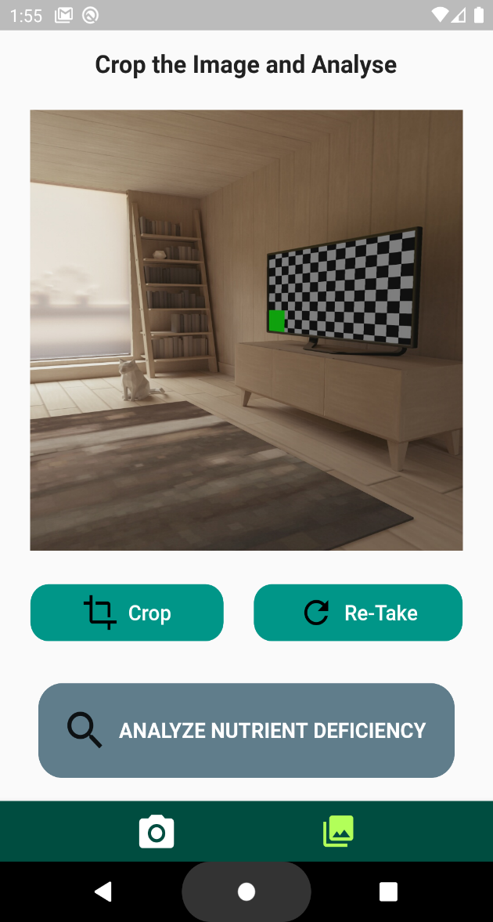
Capture Images

Slide 17

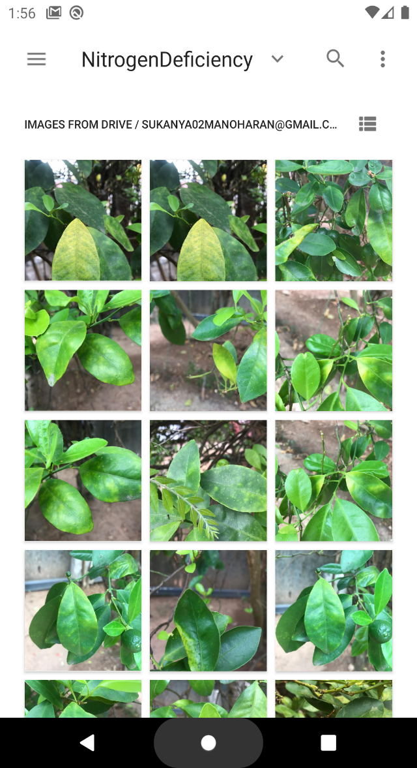
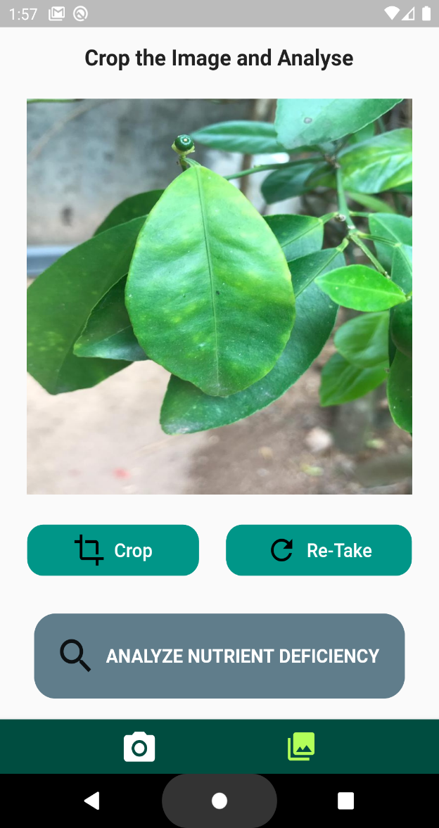
Select From
gallery

Slide 18
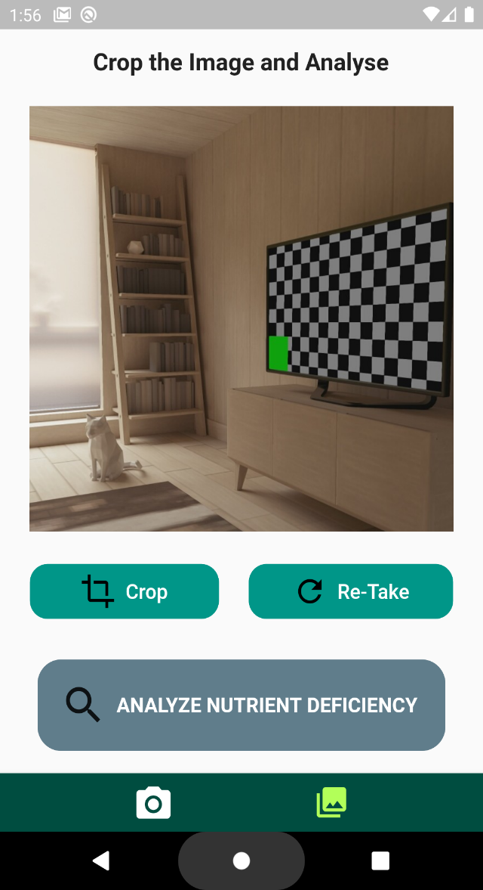
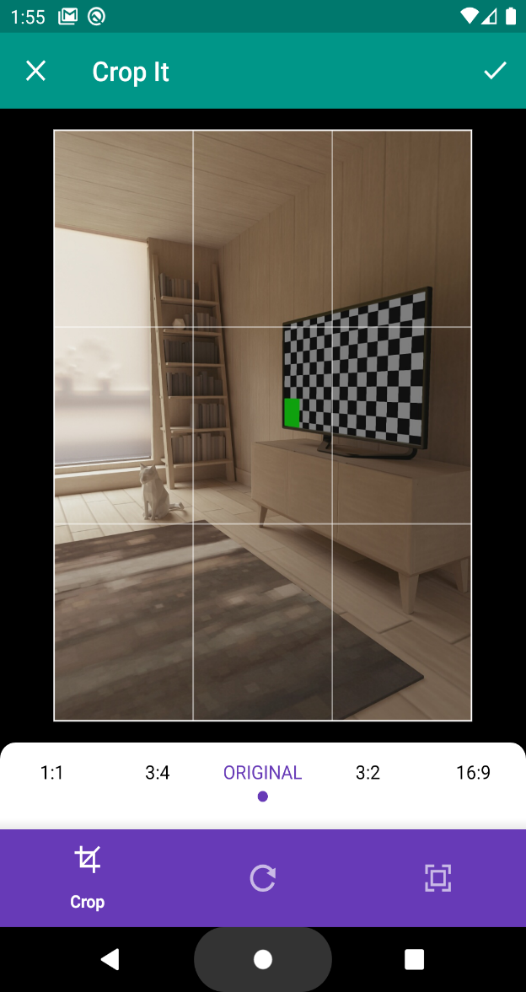
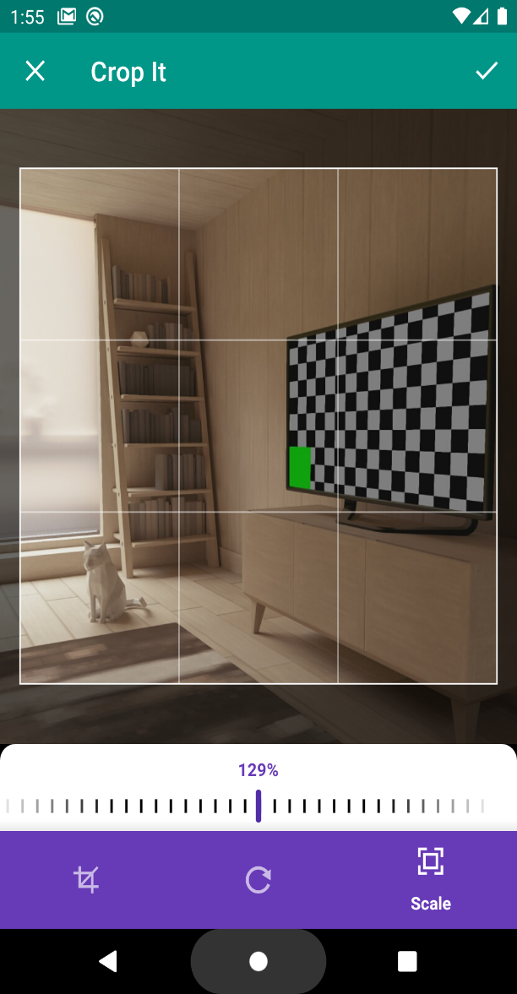
Able to Crop the selected Image

Slide 19
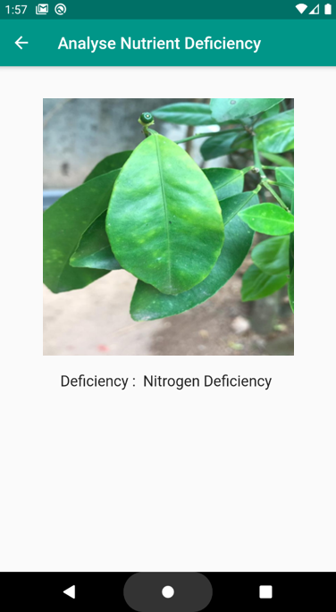
Analyze Nutrient deficiency

Slide 20
Next steps
01
Collect the datasets for NPK in cash crops and do prediction using this model
02
Connect the trained model with our mobile app – Backend Development
03
Connect the mobile app with the CloudStore and store the captured/ uploaded images into the Cloud.
04
Integrating the System

Slide 21
COMPONENT TWO
Detection of Degree of Nutrient Deficiency and Recommendation
of Solution

Slide 22
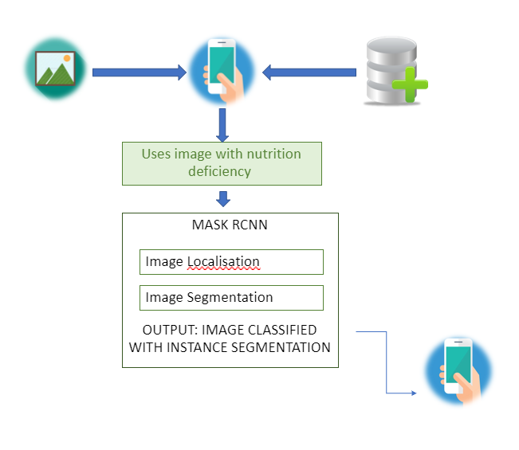
Solution implementation
Identify extent of nutrition deficiency by implementing a Mask RCNN
01
Integrate it to the main application and other components
02

Slide 23
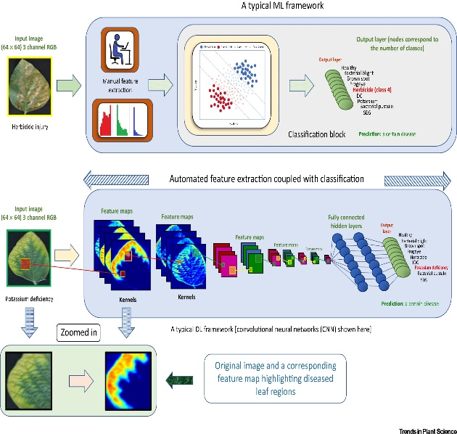
degree of Nutrient deficiency prediction -WORK FLOW
1
Data Collection
√
2
Image annotation
√
3
Transfer Learning
√
4
Deploying the Mask RCNN Model
√
5
Training the Model with annotated dataset
√
6
Provide image classified output in a numeric form for better user-ability
7
Integrating model with main application and the rest of the components

Slide 24
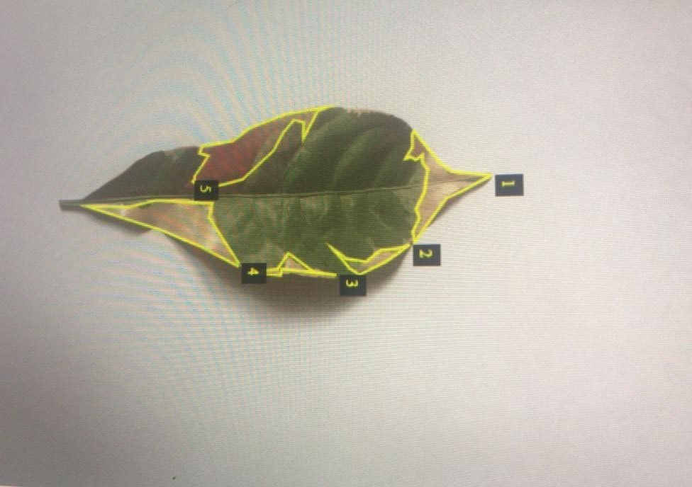
Data Collection and annotation
300
Images of green-white leaf categorisd
03 Classes
<30%, 30%-70%, >70%

Slide 25
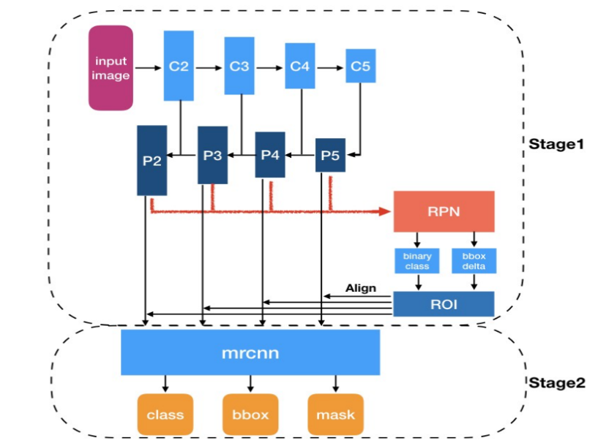
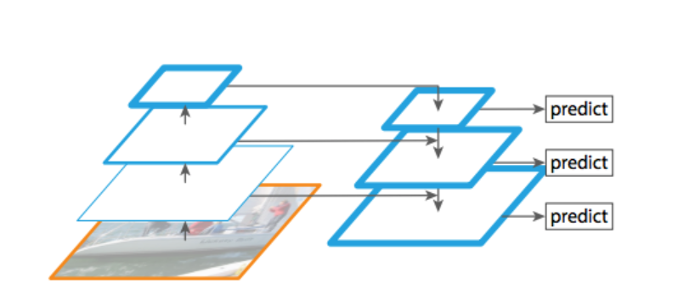
Transfer learning and deploying model
ARCHITECTURE
ResNet101
Feature Pyramid Network
COCO Weights
Components - Functional
Region Proposal Network
Region of Interest Classifier

Slide 26
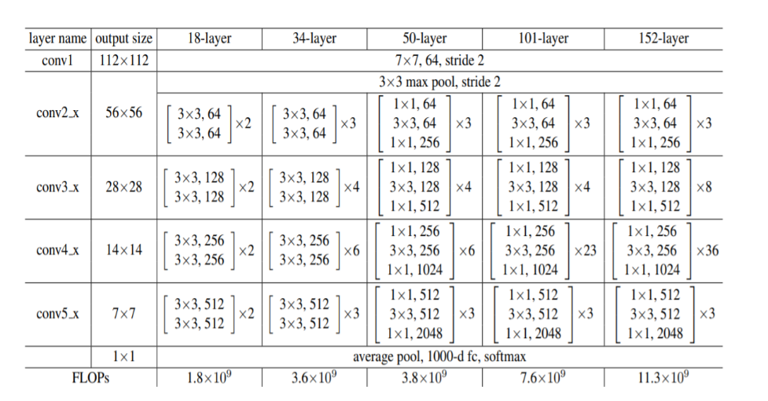
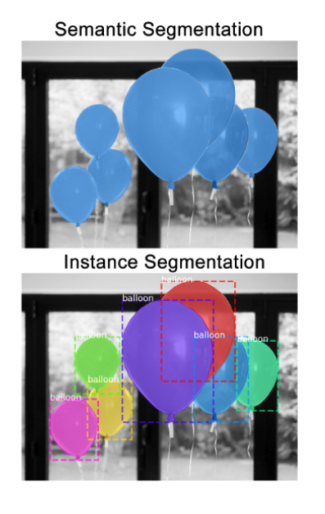
Transfer learning and deploying model
ResNet structure
Final Outcome:
Instance segmentation with bounding boxes

Slide 27
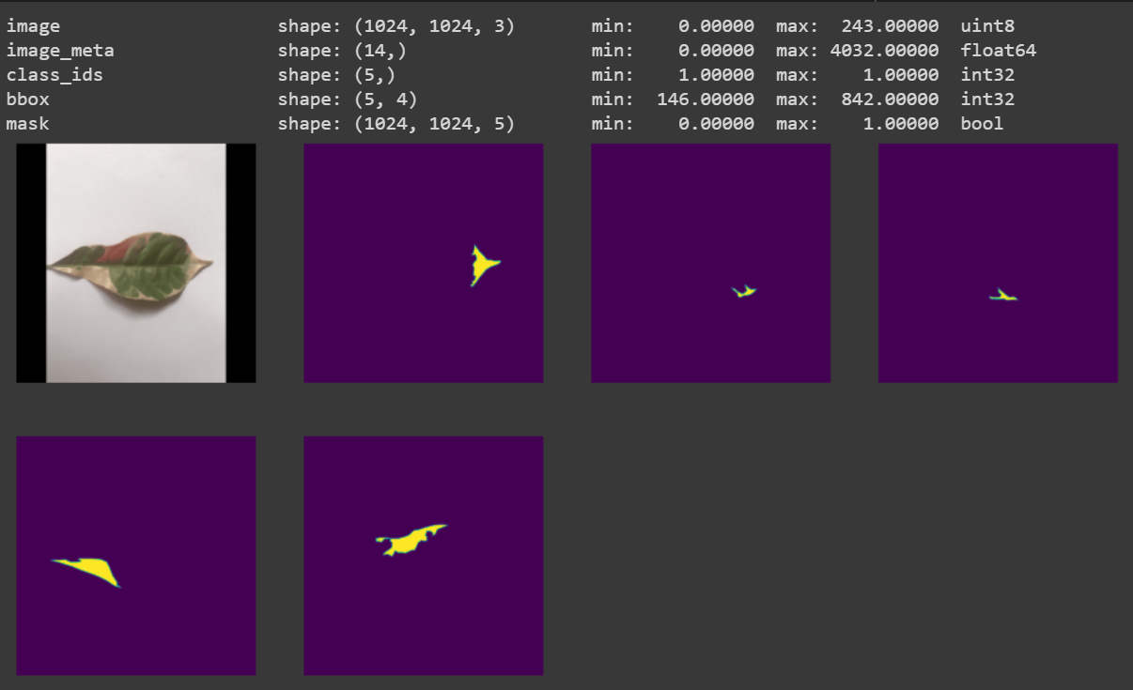
Results and code segments

Slide 28
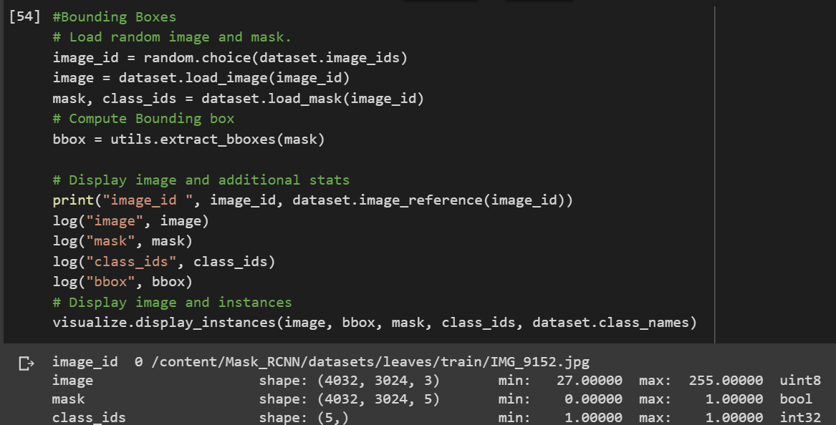
Results and code segments

Slide 29
degree of Nutrient deficiency prediction – NEXT
1
Data Collection
√
2
Image annotation
√
3
Transfer Learning
√
4
Deploying the Mask RCNN Model
√
5
Training the Model with annotated dataset
√
6
Provide image classified output in a numeric form for better user-ability
7
Integrating model with main application and the rest of the components

Slide 30
COMPONENT THREE
Develop an IOT device to measure key nutrient values of soil
K.T. Ramasinghe
IT15070418

Slide 31
Modifications of The component?
Developing IOT device to calculate soil nutrients level
(N,P,K) by using colorimetric principle
Developing IOT device to calculate pH, Humidity, Electrical Conductivity, temperature and predict
N,P,K values by a machine learning model.

Slide 32


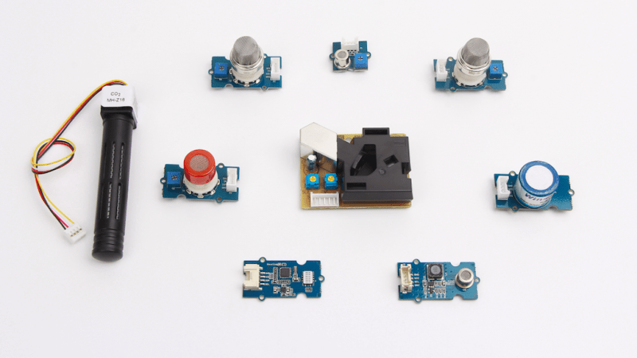
Solution implementation
Soil nutrients
values in
2 minutes
Machine learning model to predict NPK level
of soil with usage of pH, Humidity, Electrical
Conductivity and Temperature.
01
Develop an IOT device to calculate pH, Humidity, Electrical Conductivity and Temperature
Selected Soil Sample.
02

Slide 33
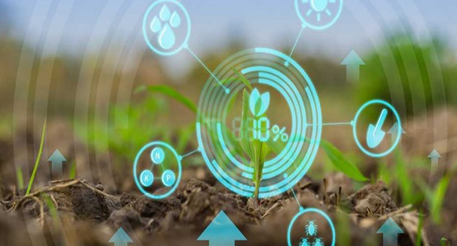
Analysis Soil Condition using an IoT Device
1
Study about plant disorders
2
Soil analysis
N
P
K
3
Data Collection & Preprocessing
4
Building the linear regression model
5
Studying about IOT
6
Developing the IOT device
7
Developing firebase connection and test model

Slide 34
Workflow…
Sensor
Readings
Prediction
of NPK
condition
Soil nutrient
values as
inputs
for main
algorithm

Slide 35
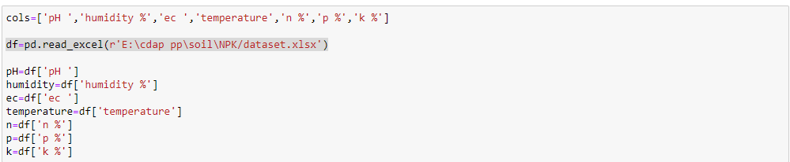
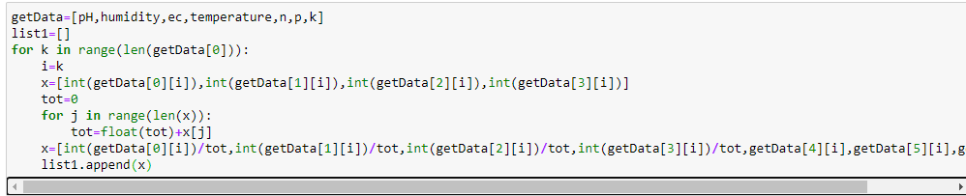
Building The Model

Slide 36
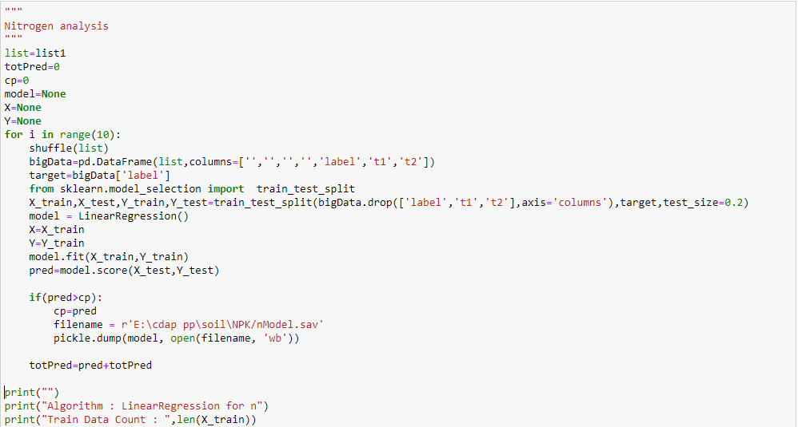
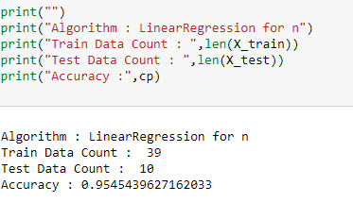
Building The Model
Why Sklearn?

Slide 37
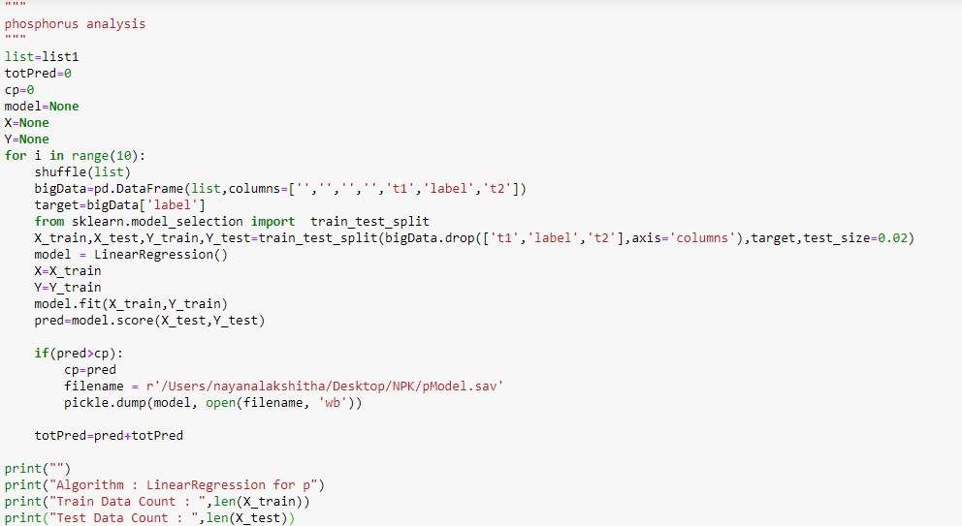

Building The Model

Slide 38


Building The Model

Slide 39

Component Overview
Display
Sensor readings
Display sub system
ESP 32
Micro controller
Generate NPK
Values using
ML algorithm
API
Cloud
Calculate average
NPK amounts
Preprocessing sub system
Preprocessing
Soil nutrient values for main algorithm as inputs

Slide 40
Next progress
01
20%
Developing the IOT device
02
05%
Implementing firebase connection
03
05%
Implementing Test model
04
10%
Integrating the System

Slide 41
Analysis Soil Condition Using an IOT Device
1
Study about plant disorders
2
Soil analysis
N
P
K
3
Data Collection & Preprocessing
4
Building the linear regression model
5
Studying about IOT
6
Developing the IOT device
7
Developing firebase connection and test model

Slide 42
COMPONENT FOUR
Implement a secure and distributed platform for identifying best commercial
product for deficiency based on diagnosis
B. I. Sariffodeen
IT17354516

Slide 43

Research question
1
What is the context of the current ecosystem for fertilizer purchasing and administering?
2
What are the existing similar systems in the market & how improvements can be made on information symmetry?
3
How can a community driven decentralized solution be implemented to streamline these proceedings?

Slide 44
Workflow
1
Identify best Suited approach for network
2
Structure 3-peer network and instantiate Chaincode
3
Build best suited API
4
Develop suitable Mobile Application
5
Integrate System to run on Blockchain

Slide 45

Current Context
3 peer network constructed based on byfn.sh shell executable file available in fabric-samples.
Functionality achieved:
All 3 entities can register and login (first time registration may take time because peers should communicate their copy of ledger on first sign-up)
Farmer can receive expert advice by describing his problem.
Famer can view his request sent to the expert & see if there's any response
Farmer can ask vendor for product by describing product and view response.
Farmer and Expert can also view product posted by vendors and their reviews.
Vendor can advertise products and handout quotations.
Expert can give farmer advice privately.
Expert can rate product without vendor knowing.

Slide 46






3-peer network for Farmer, Vendor & Expert parties

Slide 47



Slide 48
Next progress
01
15%
Integrate other Components to System
02
05%
Understand & Configure required changes in
Chaincode
03
20%
Implementing Mobile Application

Slide 49




Component 1
Component 2
Component 3
Component 4
60%
60%
60%
60%
Nutrient deficiency Identification
Degree of Disorder Identification & Remedy Suggestion
Develop an IOT device measure key nutrient values of soil
Secure and distributed platform to identify best commercial option
Objectives
Study Plant disorders and symptoms
Sample Data Collection
Preprocessing
CNN building, prediction and testing
Wireframe design & Mobile UI Dev.
Collect dataset for cash crop.
Backend Dev. – Integrate model with mobile app and connect to CloudStore.
Objectives
Study Plant disorders and symptoms
Sample Data Collection
Preprocessing
RCNN building, prediction and testing
Wireframe design & Mobile UI Dev.
Collect dataset for cash crop.
Backend Dev. – Integrate model with mobile app and connect to CloudStore.
Objectives
Study about Soil Nutrients
Find the Colon Metric Mechanism for each element
Study about photodiodes and sensors
Make a formula for color variation due to nutrient variation.
Select suitable API.
Develop the Device.
Objectives
Study about real world applicability to component.
Identify best suited approach for blockchain implementation.
Structure the required 3-peer network.
Construct suitable Chaincode.
Construct suitable API.
Build suitable Mobile Application.
Integrate other components to run on Blockchain network.

